Slide 1

IBM SkillsBuild for Adult Learners - Data Analytics
Data Analytics Internship Program 2024
Final Project Presentation
Project Name : Social Media : The Health Crisis
Unique ID : IBM0361
Team Name : Data Detectives
College Name : BBK DAV College for women , Amritsar

Slide 2


SOCIAL MEDIA: THE HEALTH CRISIS
DATA DETECTIVES

Slide 3



INTRODUCTION
Overview
Social Media has become an integral part of modern life influencing various aspects of human behavior and well-being. This project aims to analyze the impact of social media usage on human health, focusing on both positive and negative outcomes. By leveraging data analysis tools and methodologies, the project seeks to understand how social media affects mental and physical health and to propose strategies for mitigating any adverse effects.
DATA DETECTIVES

Slide 4



Objective
To collect and analyze data on social media usage patterns.
To identify the negative health outcomes associated with social media use.
To understand the demographic and behavioral factors that influence these outcomes.
To develop predictive models to identify individuals at risk of adverse health effects due to social media use.
To propose actionable strategies and recommendations to promote healthy social media habits.
To assess the potential impact of these strategies on achieving SDG 3.
DATA DETECTIVES

Slide 5
PROBLEM IDENTIFICATION
Problem Statement
The rapid expansion of social media platforms has brought about significant changes in the way people communicate, interact, and consume information. While social media offers numerous benefits, such as enhanced connectivity, access to information, and social support, it also poses risks to mental and physical health. Excessive use of social media has been linked to issues such as anxiety, depression, sleep disturbances, and motionless behaviour. Despite growing concerns, there is a need for comprehensive data-driven studies to understand the extent of these impacts and to develop effective interventions. This project seeks to address this gap by analysing social media usage data and its correlation with health outcomes.
DATA DETECTIVES
DATA DETECTIVES

Slide 6
Sustainable Development Goal
Significance of Problem
1. Behavioral Insights:
- Understanding changes in communication, social interactions, and lifestyle choices.
2. Health Risks Identification:
- Identifying links between social media use and issues like anxiety, depression, sleep disturbances, and sedentary behavior.
3. Public Health Interventions:
- Informing targeted interventions and policies to mitigate negative health impacts.
4. Mental Health Support:
- Providing data to develop resources and support systems for managing mental well-being.
5. Guidelines for Usage:
- Offering recommendations for balanced and responsible social media use.
.
The project aligns with Sustainable Development Goal 3 (SDG 3): Good Health and Well-being, which aims to ensure healthy lives and promote well-being for all at all ages.
DATA DETECTIVES

Slide 7
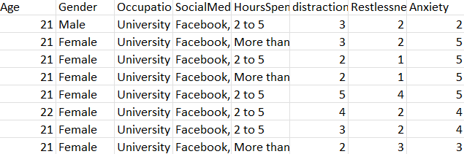
DATA COLLECTION
Source of Data
Data Description
Age, gender, and other relevant demographic information.
Measures of mental and physical health such as anxiety, depression, sleep quality and physical activity.
User Demographics
Health Indicators
Kaggle: https://www.kaggle.com/
Frequency, duration and patterns of social media use.
Lifestyle factors such as diet, exercise and social interactions.
Social Media Usage
Behavioural factors
DATA DETECTIVES

Slide 8
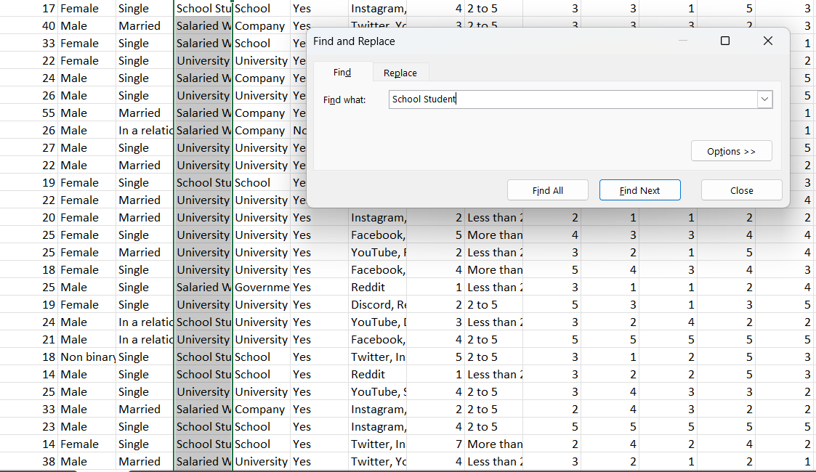
DATA PREPROCESSING
Remove Duplicates: Use the Remove Duplicates feature under the "Data" tab to eliminate repeated rows based on selected columns.
Trim Spaces: Use the TRIM function to remove extra spaces from text data.
Find and Replace: Use Find & Select to locate and replace specific values or errors.
Data Validation: Set rules for data entry to prevent incorrect data entry via the Data Validation feature under the "Data" tab
Remove Blank Rows/Columns: Manually delete or use filtering to remove blank rows or columns.
Data Cleaning Methods
DATA DETECTIVES

Slide 9
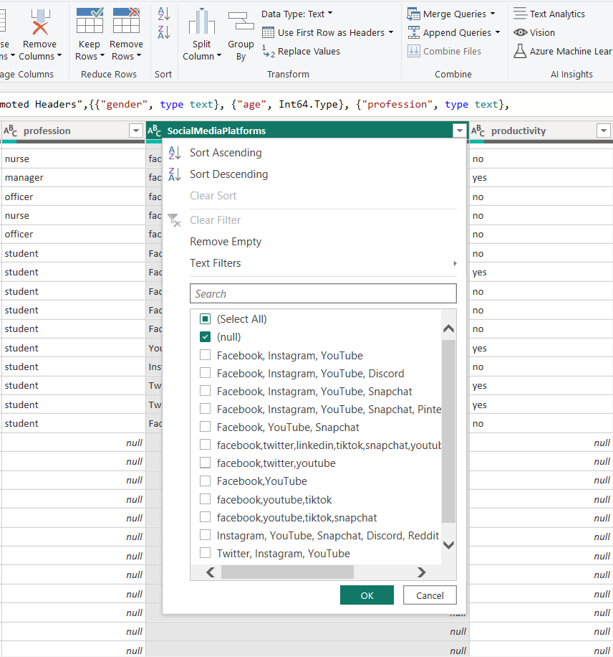

1. Remove Rows with Missing Values
- This method involves removing entire rows where any column contains a missing value.
2. Replace with a Default Value
- You can replace missing values with a default value, such as zero, a specific text, or the result of a calculation
3. Fill Down or Fill Up
- This method involves propagating the last non-missing value forward (fill down) or backward (fill up) within a column.
4. Handle Missing Values in Visuals
- When visualizing data in Power BI reports, you can control how missing values are displayed
- You can customize how missing values are represented (e.g., as blanks, zeros, or other placeholders).
.
Handling Missing Values
DATA DETECTIVES

Slide 10
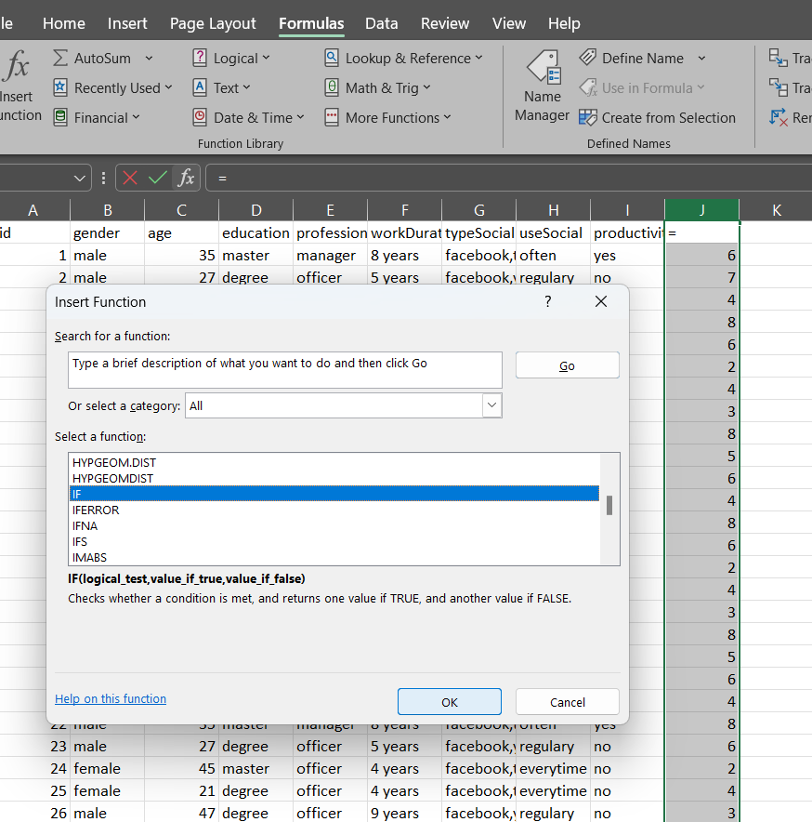
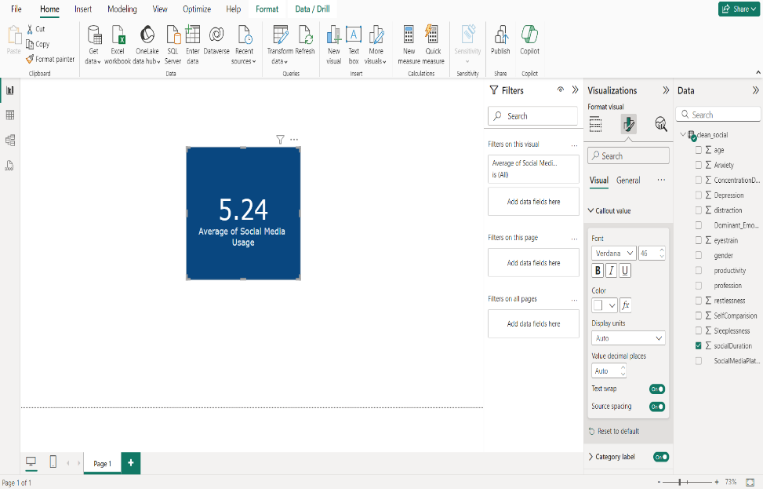

1.Text-to-Columns:
- Split data into multiple columns based on delimiters.
2. Power Query:
- Use Power Query to filter, merge, and transform data with a graphical interface.
3. Formulas and Functions:
- Apply formulas (e.g., VLOOKUP, INDEX, MATCH, IF) to transform data or perform calculations.
4. Data Consolidation:
- Combine data from multiple sheets or workbooks using consolidation features.
Data Transformation Techniques
1. Power Query Editor: - Use the Power Query Editor to transform data by filtering, merging, appending, and shaping it.
2. Data Modeling:
- Define relationships between tables to create a unified data model for analysis.
3. Merging Queries:
- Combine multiple queries to enrich data and perform advanced transformations.
4. Grouping and Aggregating:
- Group data and calculate aggregations like sums, averages, or counts for analysis.
DATA DETECTIVES

Slide 11


DATA ANALYSIS
Data Preparation: Cleaning, transforming, and modelling data for analysis.
Statistical Analysis: Using statistical functions to understand data distribution, correlations, and trends.
Time Series Analysis: Analysing data over time to identify patterns.
Data Visualization: Creating visual representations to explore, communicate, and understand data.
Predictive Modelling: Forecasting future trends based on historical data.
Basic Calculations:
Sum, average, count, min, max.
Data Cleaning:
Sorting, filtering, removing duplicates.
Data Transformation:
Text to columns, concatenate, find/replace.
Statistical Analysis:
Average, standard deviation, correlation, regression.
Data Visualization:
Charts, graphs, pivot tables.
What-If Analysis:
Goal seek, data tables, scenarios.
Analytical Tools and Methods
DATA DETECTIVES

Slide 12
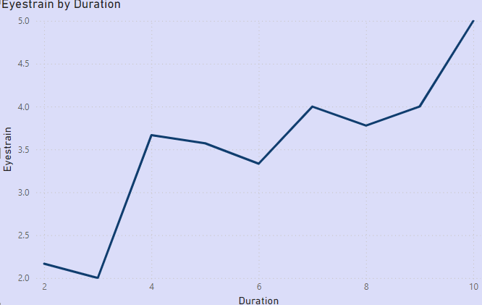
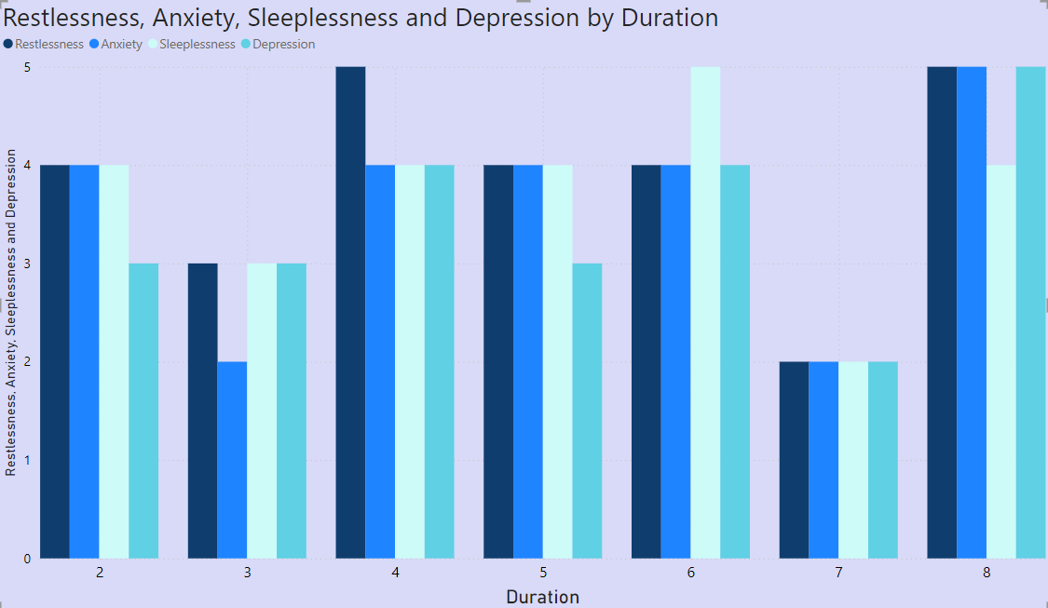
KEY FINDINGS AND INSIGHTS DERIVED
The graph paints a vivid picture of eyestrain escalating with prolonged screen exposure. It's a relentless climb, punctuated by brief plateaus, before culminating in a steep ascent, mirroring the growing discomfort as hours tick by.
The chart shows how strong feelings of restlessness, anxiety, sleeplessness, and depression can be over time. The taller the bar, the stronger the feeling. It looks like these feelings go up and down, but sometimes they get really high.
DATA DETECTIVES

Slide 13

HYPOTHESIS DEVELOPMENT
-
FORMULATED HYPOTHESIS
METHODS FOR TESTING HYPOTHESIS
Higher social media usage correlates with increased anxiety and depression levels.
Positive social media interactions improve overall self-esteem and mental well-being
Excessive social media use disrupts sleep quality and patterns.
Social media influences body image concerns and eating disorders. Engagement in online health communities enhances chronic disease management.
Use surveys to measure social media use and mental health symptoms.
Perform experiments with controlled exposure to positive or neutral content, and compare self-esteem levels before and after exposure.
Track sleep quality using sleep monitors or self-reports among high and low social media users
Administer surveys to assess body image concerns and social media usage, and analyze content related to body image.
DATA DETECTIVES

Slide 14
SOLUTION DESIGN
PROPOSED SOLUTION
Education: Teach digital literacy and the effects of social media on health.
Time Management: Set limits on social media use and promote mindful engagement.
Positive Content: Encourage creation and sharing of uplifting and supportive content.
Balanced Activities: Promote real-life social interactions alongside online engagement.
Mental Health Integration: Include mental health resources and support within social media platforms.
IMPLEMENTATION PLAN
Programs , Workshops
Tools , Guidance
Campaigns , Moderation
Encouragement , Programs
Features , Partnerships
DATA DETECTIVES

Slide 15
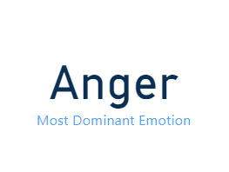
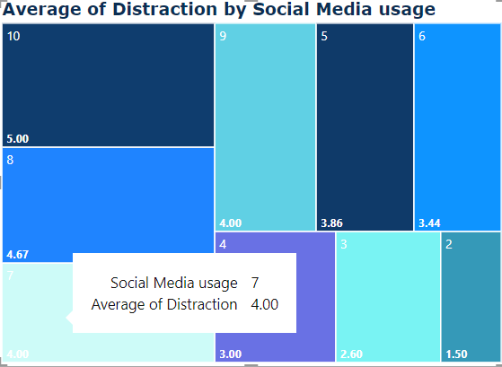
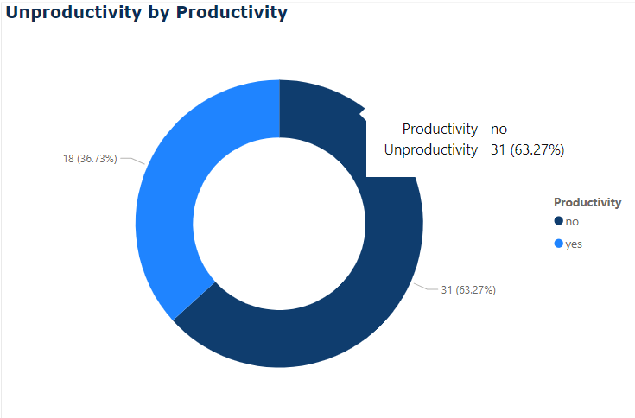
VISUALIZATION
DATA DETECTIVES

Slide 16
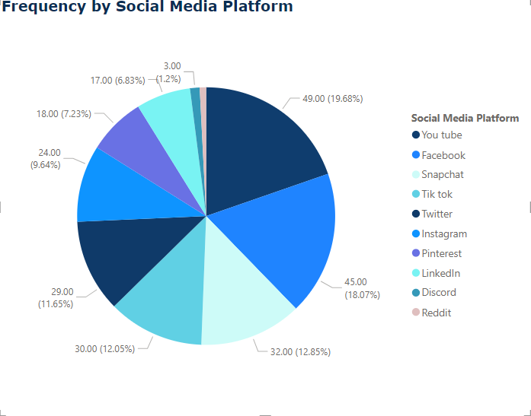
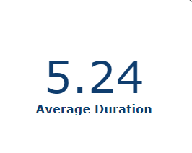
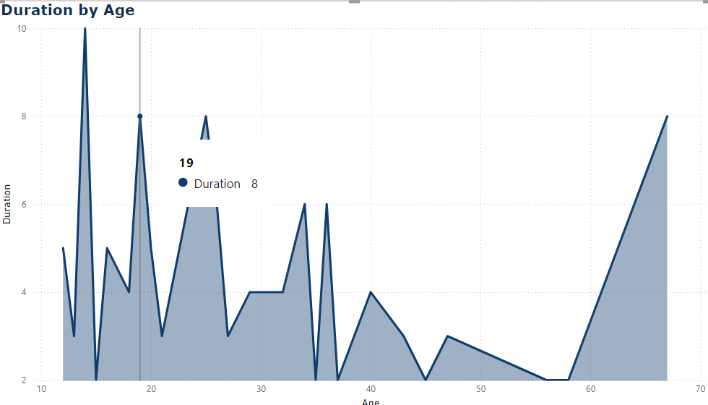
Data Visualization Techniques
DATA DETECTIVES

Slide 17
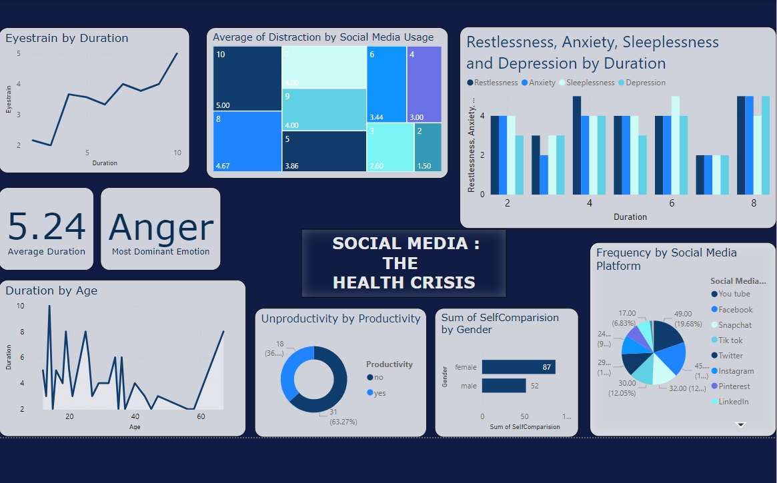
Visual Insights
DATA DETECTIVES

Slide 18
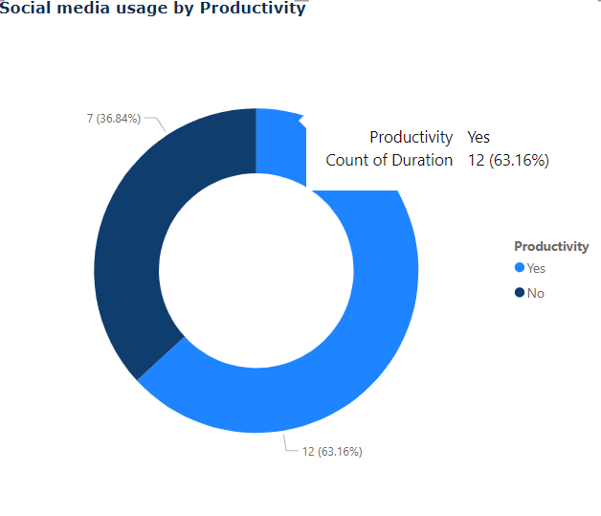
CONCLUSION
Social media can positively impact human health by providing support and resources, but it also has drawbacks. Excessive use is linked to increased anxiety, depression, and poor sleep, along with potential physical issues like sedentary behavior and posture problems. Balancing social media use is essential to mitigate these negative effects while leveraging its benefits.
Impact of Proposed Solution
Before
After
DATA DETECTIVES

Slide 19



References
DATA DETECTIVES

Slide 20





TEAM MEMBERS
Gunpreet Kaur
Riya Saini
Riya Sharma
Siya Gupta
Taruni Batra
DATA DETECTIVES

Slide 21

DATA DETECTIVES

